Slide 1
DIGITAL IMAGE PROCESSING FINAL REVIEW
TEAM MEMBERS
PORSHIA JOAN 20MIS1017
GAGANYA MOHAN 20MIS1126
ANGELINE VENICIA.B 20MIS1158

Slide 2
INTRODUCTION
Brain Tumor is a fatal disease which cannot be confidently detected without MRI. In the project, it is tried to detect whether patient’s brain has tumor or not from MRI image using MATLAB simulation. To pave the way for morphological operation on MRI image, the image was first filtered using Anisotropic Diffusion Filter to reduce contrast between consecutive pixels. After that the image was resized and utilizing a threshold value image was converted to a black and white image manually. This primary filter the plausible locations for tumor presence. On this semi processed image morphological operations have been applied and information on solidity and areas of the plausible locations was obtained. A minimum value of both of this characters has been determined from statistical average of different MRI images containing tumor. Then it was used to deliver final detection result.

Slide 3
LITERAtURE SURVEY
Rasel Ahmmed Anirban Sen Swkshar, Md. Foisal Hossain, Md. Abdur Rafiq [4] proposed method which include stages like image pre-processing, segmentation, feature extraction, SVM classification and tumor stage classification using Artificial Neural Network (ANN). Key image processing techniques for brain MRI image segmentation is classified as
SVM, FCM. Swapnil R. Telrandhe, et. al [5] Proposed tumor detection inside which Segmentation separates an image into parts of regions or objects. In this it has to segment the item from the background to browse the image properly and classify the content of the image strictly. During this framework, edge detection is a vital tool for image segmentation. In this paper their effort was made to study the performance of most commonly used edge detection techniques for image segmentation and additionally the comparison of these techniques was carried out with an experiment. Preliminary results show that our approach has achieved good segmentation results. Also this approach was reduces a large quantity of calculation.
Rajeshwari G tayade et.al [13], in their paper they gave a mixture of wavelet statistical features and co-occurrence wavelet texture feature obtained from two level distinct riffle remodel was used for the organization of abnormal brain matters in to benign and malignant. The planned system was consists of four stages: segmentation of region of interest, separate ripple disintegration, feature abstraction, feature choice, organization and analysis. The support vector machine was used for tumor segmentation. A grouping of WST and WCT was used for feature extraction of neoplasm region extracted from second level separate ripple remodel. Genetic algorithm was used to choose the best texture options from the set of well-mined options.

Slide 4
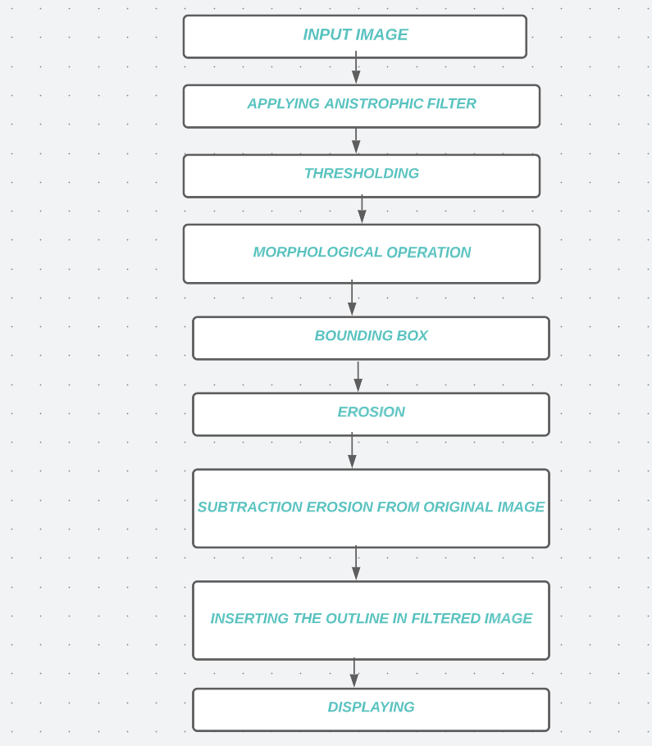
METHODOLOGY

Slide 5
METHODOLOGY
INPUT IMAGE: This is the first step of the proposed system. The resulting MRI images may not be of very good quality for analysis. Images can be noisy, blurry, low-contrast. The area of interest can be difficult to extract .Here, grayscale MRI images are provided as input to the system
PREPROCESSING: This is the initial processing of data in order to prepare them for primary processing or further analysis. The preprocessing phase of our project mainly includes those operations that are usually necessary before the target analysis and extraction of the necessary data and usually geometric corrections of the original image. These improvements include correcting information for jaggedness and unwanted noise in an area, removing an image of a non-brain element, and transforming the data so that it reflects correctly in the original image. The first preprocessing step is to transform this input MRI image into a suitable form with which further work can be done.
FEATURE EXTRACTION: It is the process by which certain features of interest in an image are detected and presented for further processing. This is an important step in most computer vision and imaging solutions. Based on the results obtained during the extraction of signs, the tumor is classified. When extracting, certain parameters are taken into account: size, shape, composition, image location. This step extracts the Features of the given input image. Based on these characteristics, the image is analyzed and the area of the tumor is determined.
IMAGE ANALYSIS: The output is analyzed and displayed either as no tumor or tumor detected with its output

Slide 6
HARDWARE AND SOFTWARE REQUIREMENTS
HARDWARE
Processors.
Minimum: Any Intel or AMD x86-64 processor.
Recommended: Any Intel or AMD x86-64 processor with four logical cores and AVX2 instruction set support.
Disk.
Minimum: 3.4 GB of disk space for MATLAB only, 5-8 GB for a typical installation. Recommended: An SSD is recommended. ...
RAM.
Minimum: 4 GB. Recommended: 8 GB.
Operating Systems
Window 7 and above
SOFTWARE
Matlab version 2022b

Slide 7
CONCLUSION
In this research, we have used brain MRI images, segmented into normal brain tissue (unaffected) and abnormal tumor tissue (infected). To remove a noise and smoothen the image, preprocessing is used which also results in the improvement of signal-to-noise ratio. We have applied thresholding and morphological operations to extract the boundary and detect the tumor.
The larger goal of the project is to build a data base of 2D image data of tumor from the MRI images taken from different angle of a particular human and by analyzing them to point out the exact 3D location of the tumor . To fulfill this, 2D tumor detection and segmentation have been developed to better accuracy so that 3D detection can be more reliable. This is the primary target of the project.

Slide 8
FUTURE WORK
From the observation results, it can be clearly expressed that the detection of brain tumor is fast and accurate when compared to the manual detection carried out by clinical experts. The performance factors evaluated also shows that it gives better outcome by improving PSNR and MSE parameters.
The proposed methodology results in accurate and speedy detection of tumor in brain along with identification of precise location of the tumor.
With the above results, we conclude that our proposed method clearly distinguishes the tumor into tumor detected and no tumor which helps in taking clear diagnosis decisions by clinical experts.
In the future work, different classifiers can be used to increase the accuracy combining more efficient segmentation and feature extraction techniques with real- and clinical-based cases by using large dataset covering different scenarios.

Slide 9
REFERENCES
[1]. Rajeshwari G tayade,Michel Crucian , “Unsupervised And Semi-Supervised Clustering: A Brief Survey,” Inria Rocquencourt, B.P. 105 78153 Le Chesnay Cedex, France.
[2]. “Brain Tumors Clssifications,Symptoms,Dignosis and Treatments. ”Online Available:https://www.aans.org/Patients/Neurosur gicl-Conditions-nd-Treatments/BrinTumors.
[3] Swapnil R.Telrandhe,”segmentation methods for medical image analysis”,tesis no 1434,center for medical image science and visualization ,se-58185 linkoping ,Sweden.
[4]. Rasel Ahmmed Anirban Sen Swkshar,Md.Foisal ,and Md.Abdur Rafiq”Classification of Tumors and It Stages in Brain MRI Using Support Vector Machine and Artificial Neural Network”in International Conference on Eletrical,Computer and Communication Engineering(ECCE),Cox’s Bazar,Bangladesh,February 16-18,2017.
[5]. Sijbers J et al (1998), “Estimation of the noise in magnitude MR images”, Magn Reson Imaging 16(1):87- 90.
[6]. MathWorks (https://in.mathworks.com/help/wavelet/ug/lifting-method-forconstructingwavelets.html).

Slide 10
THANK YOU

